Slide 1

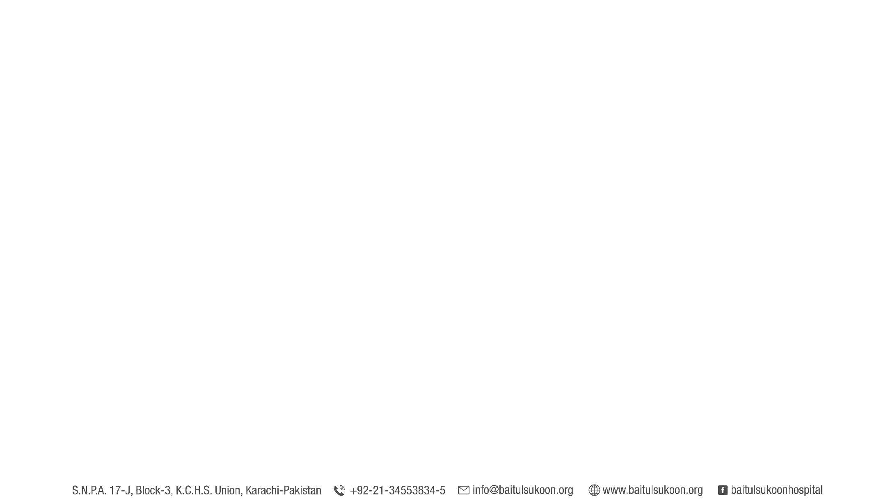
Sponsor a Treatment/Service
No donation is too large or too small.
 | Medical Services | Sponsorship Cost (PKR)
1 | Chemotherapy (Average Sessions per patient - 16) | 25,000/- (Per Session)
2 | Targeted Therapy (Average Sessions per patient - 12) | 55,000/- (Per Session)
3 | Radiotherapy (Average Fractions per patient - 20) | 3,500/- (Per Fraction)
4 | Surgery | 100,000/-
5 | Hospice Care | 5,000/- (Per Patient Per Day)
6 | Biopsy | 5,000/-
7 | Histopathology | 25,000/-
8 | Diagnostic Pathology | 2,500/-
9 | Advanced Diagnostic Radiology | MRI (Contrast Rs. 24,000/-) | CT Scan: (Chest Rs. 14,000/-) & (Abdomen Rs. 20,000/-) | Mammography (Rs. 7,000/-) | X-Rays (Rs. 1,500/-) | Ultrasound (Rs. 4,000/-) |

Slide 2


Sponsor a Treatment/Service
No donation is too large or too small.
Chemotherapy
It is a cancer treatment where medicine is used to kill cancer cells. There are many different types of chemotherapy medicine, but they all work in a similar way. They stop cancer cells from reproducing, which prevents them from growing and spreading in the body.
Item | Sponsorship Cost
Treatment | Chemotherapy Session
Donate (PKR) | 25,000/- Per Session
Average Sessions Per Patient | 16

Slide 3
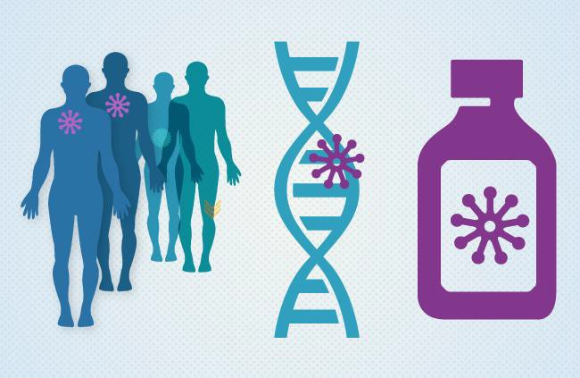
Sponsor a Treatment/Service
No donation is too large or too small.
Targeted Therapy
It is a type of therapy for cancer treatment that targets proteins that control how cancer cells grow, divide, and spread. It is the foundation of precision medicine. As researchers learn more about the DNA changes and proteins that drive cancer, they are better able to design treatments that target these proteins.
Item | Sponsorship Cost
Treatment | Targeted Therapy Session
Donate (PKR) | 55,000/- Per Session
Average Sessions Per Patient | 12

Slide 4
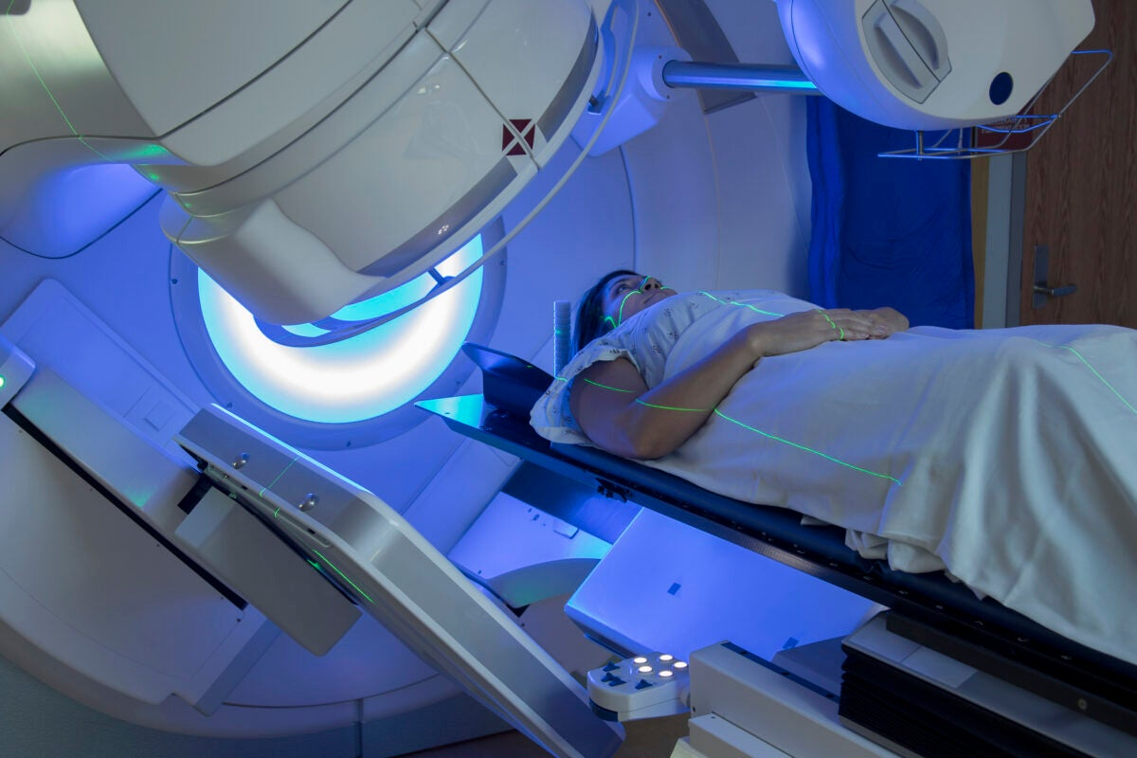
It is also called Radiation therapy, which is a cancer treatment that uses high doses of radiation to kill cancer cells and shrink the tumors.
Sponsor a Treatment/Service
No donation is too large or too small.
Radiotherapy
Item | Sponsorship Cost
Treatment | Radiotherapy Fraction
Donate (PKR) | 3,500/- Per Fraction
Average Fractions Per Patient | 20

Slide 5
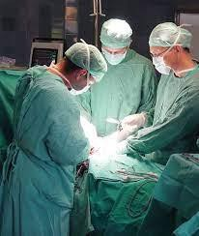
Sponsor a Treatment/Service
No donation is too large or too small.
Surgery
It is an invasive technique with the fundamental principle of a physical intervention on organs/organ systems/tissues for diagnostic or therapeutic reasons. As a general rule, a procedure is considered surgical when it involves cutting a person's tissues or the closure of a previously sustained wound.
Item | Sponsorship Cost
Treatment | Surgery
Donate (PKR) | 100,000/- Per Surgery

Slide 6

Sponsor a Treatment/Service
No donation is too large or too small.
Hospice Care
It helps treat the person and symptoms of the disease requiring pain management, rather than treating the disease itself. A team of professionals work together to manage the symptoms so that a person’s last days may be spent with comfort and quality care, surrounded by their loved ones. Hospice care is also family-centered – it includes the patient and the family in making decisions.
Item | Sponsorship Cost
Treatment | Hospice Care
Donate (PKR) | 5,000/- Per Patient Per Day

Slide 7
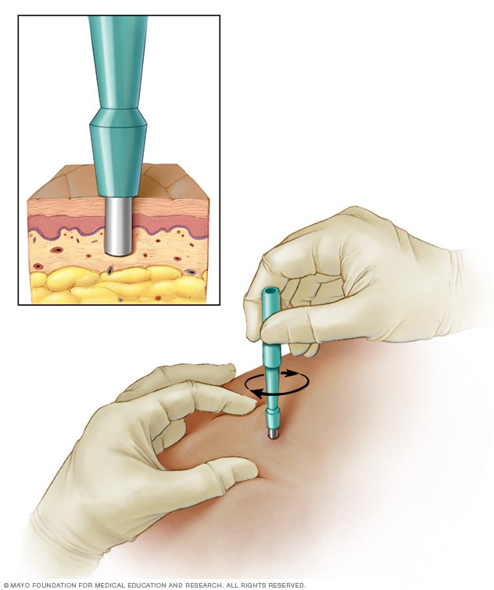
Sponsor a Treatment/Service
No donation is too large or too small.
Biopsy
It is a medical procedure that involves taking a small sample of body tissue so it can be examined under a microscope. A tissue sample can be taken from almost anywhere on or in your body, including the skin, organs and other structures.
Item | Sponsorship Cost
Procedure | Biopsy
Donate (PKR) | 5,000/- Per Biopsy

Slide 8
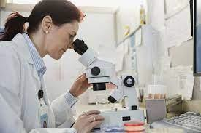
Sponsor a Treatment/Service
No donation is too large or too small.
Histopathology
It means using a microscope to look at human tissue to see if it has signs of any diseases, damage, or other abnormalities.
Histopathology reports can include descriptions of the tissue, diagnosis, and prognosis. In addition to evaluating the shape and structure of cells, pathologists may also use other techniques to assess and diagnose cancer.
Item | Sponsorship Cost
Diagnostic | Histopathology
Donate (PKR) | 25,000/- Per Histopathology

Slide 9
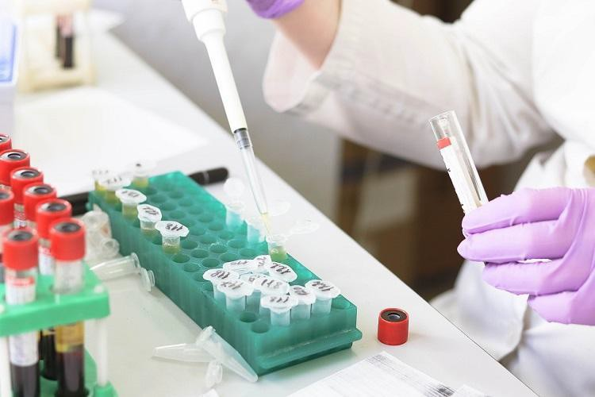
Sponsor a Treatment/Service
No donation is too large or too small.
Diagnostic Pathology
It identifies the cause of disease based on morphologic and/or clinical pathology findings, as well as history, clinical signs, and ancillary test results. It is important in all areas of pathology, both in spontaneous and experimentally-induced diseases.
Item | Sponsorship Cost
Diagnostic | Routine Tests
Donate (PKR) | 2,500/- Per Misc. Test

Slide 10
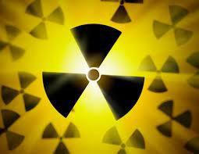
Sponsor a Treatment/Service
No donation is too large or too small.
Advanced Diagnostic Radiology
It is an advanced diagnostic imaging procedure and includes diagnostic magnetic resonance imaging (MRI), computed tomography (CT), nuclear medicine imaging procedures, such as positron emission tomography (PET), etc.
Item | Sponsorship Cost (PKR)
MRI | 24,000/- (Contrast)
CT Scan | 14,000/- (Chest) 20,000/- (Abdomen)
Mammography | 7,000/-
X- Rays | 1,500/-
Ultrasound | 4,000/-

